Slide 1
Music generation with Diffusion models - updates
Bojescu Mihai, 2025

Slide 2
Agenda
Progress
Future work

Slide 3
Progress

Slide 4
Progress
Data
Model
Pipeline:
  Preprocessing
  Training loop

Slide 5
Data
The dataset is composed of:
  710 songs, with different genres, some with lyrics
  1106 labels, with multiple labels per song
The dataset is freely available on Huggingface

Slide 6
Model
Currently, the model is a “Diffusion Transformer”, with:
  4 Transformer blocks, with 4 Attention heads each
  Patch embedding and de-embedding is done using CNNs
  Timestep embedding and is done via a Dense network
Number of parameters is 5 388 802

Slide 7
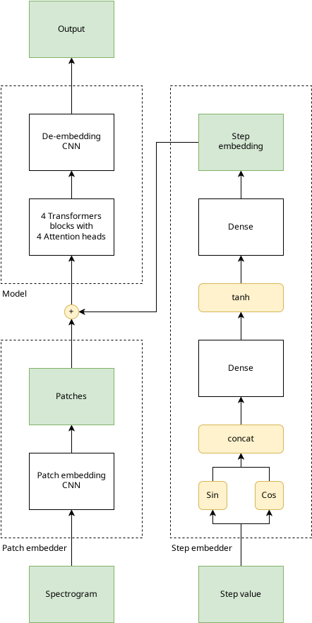

Slide 8
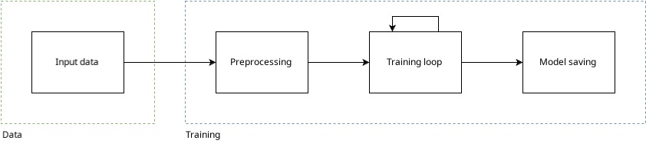
Pipeline

Slide 9
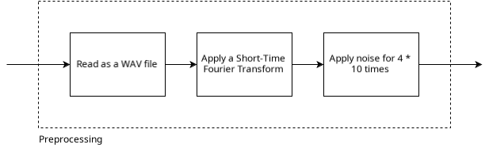
Preprocessing

Slide 10
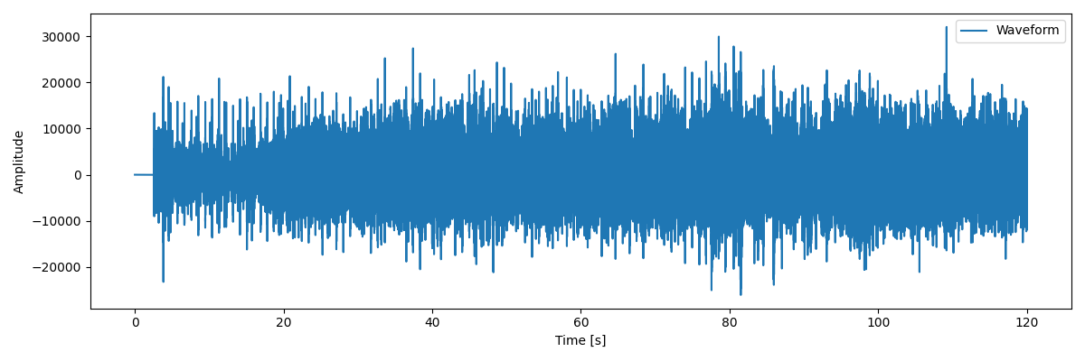
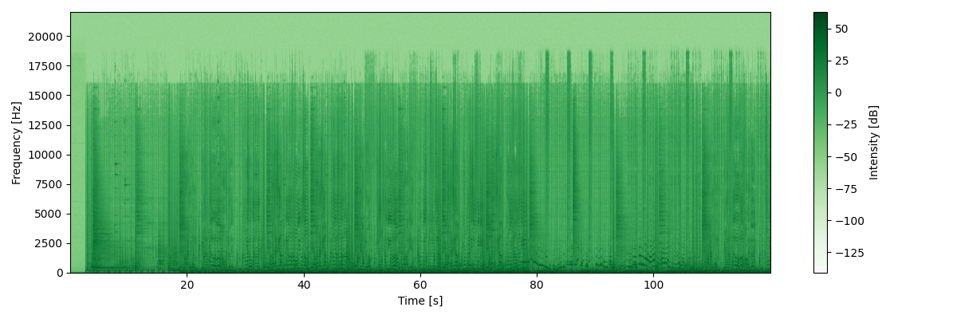
Preprocessing
Given a waveform, a Short-Time Fourier Transform is applied
A spectrogram is given as a result
The spectrogram is saved as a tensor

Slide 11
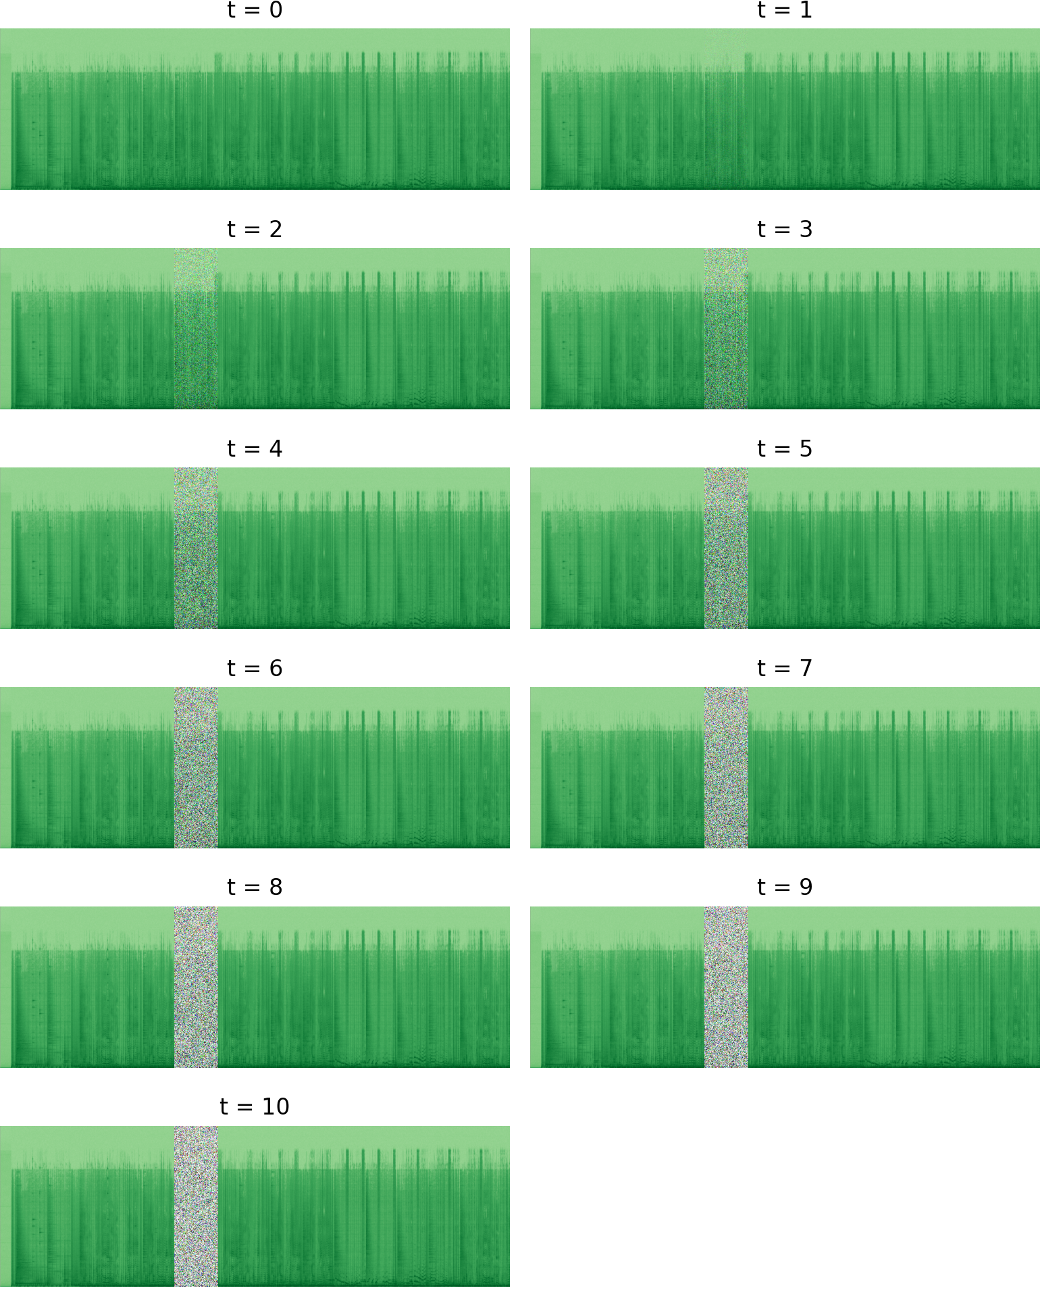
Preprocessing
The spectrogram is gradually “noised”:
  Start with an unnoised spectrogram
  For t iterations, add more noise
To get a better result, the noise scheduling process described in the “Denoising Diffusion Probabilistic Models” (Ho et al.) paper is used
The formula is:

Slide 12
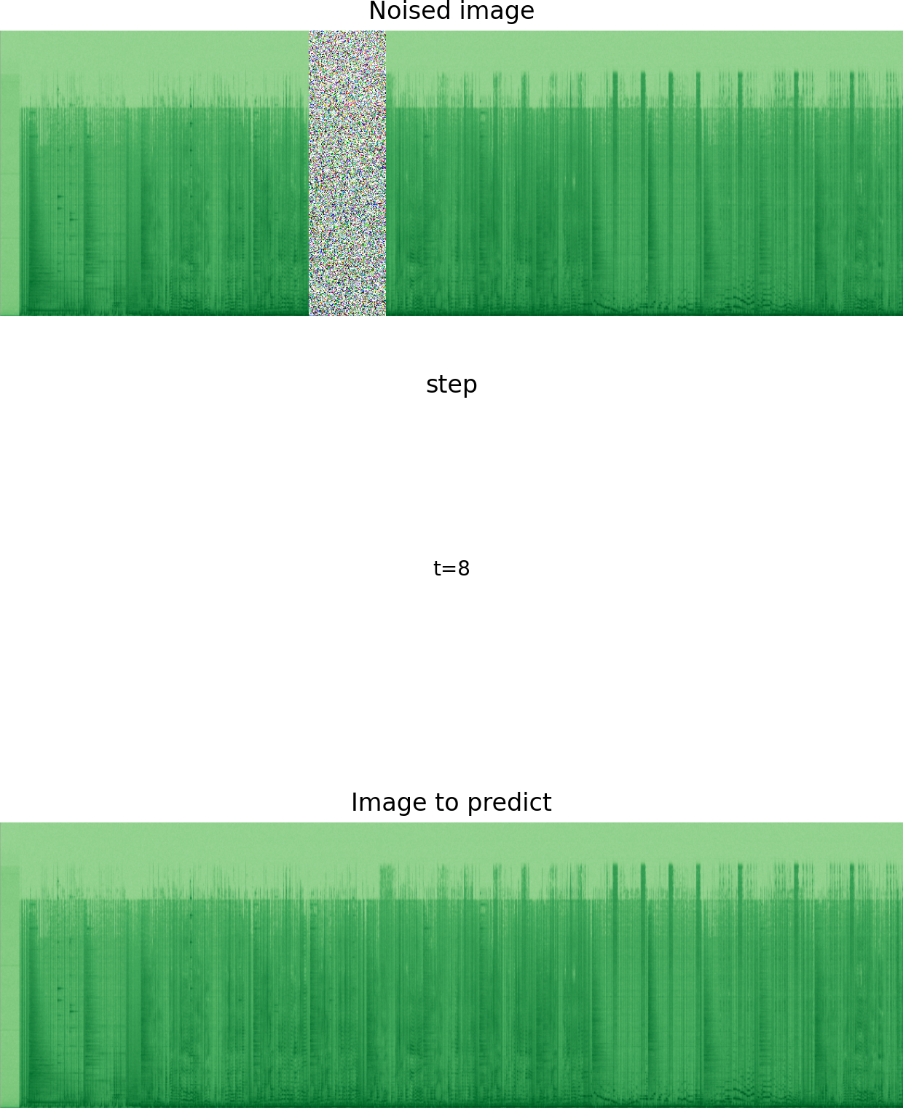
Training loop
At training, the model is given:
  A noised spectrogram
  A timestep value
The model is tasked to predict the original image
  Motivation: the model does not need to capture intermediary denoising steps, as it introduces noise
The loss is influenced by the difference between:
  The predicted denoised spectrogram
  The actual spectrogram

Slide 13
Training loop
Training loss: MSE
Training optimizer: Adam
Training statistics:
  Uses about 8GB of VRAM for training
  Training takes 5 epochs * 450s ~= 2250s on 1 GPU

Slide 14
Future work

Slide 15
Future work
Add:
  support for text-driven generation
Explore with:
  different input tensor shapes and sizes
  different learning parameters
  different model sizes
  different model configurations
Training:
  run training multiple times

Slide 16
Thank you!

